Slide 1
Association Rules
Tomas Karpati MD tc.datascience@gmail.com
054-2002430

Slide 2
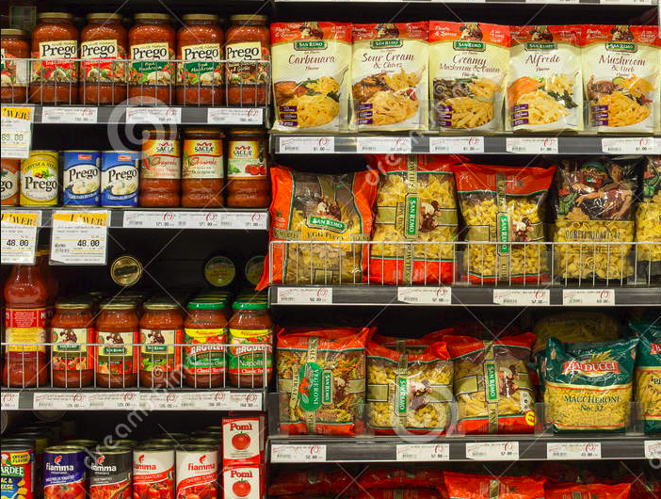
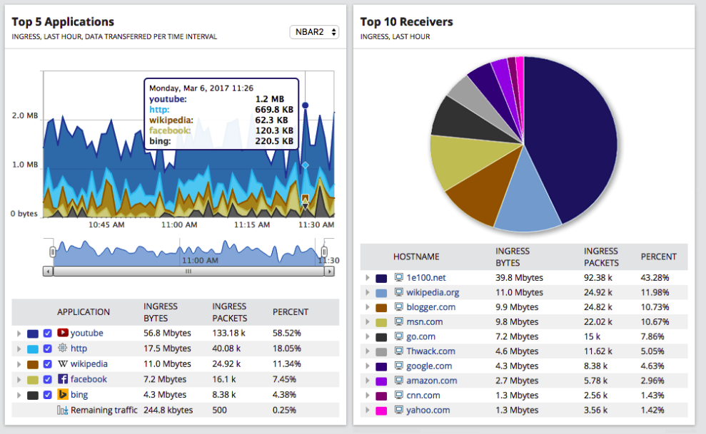
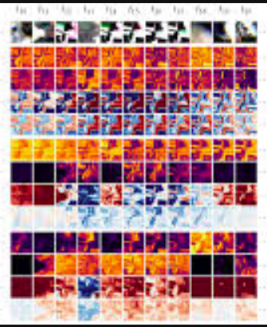
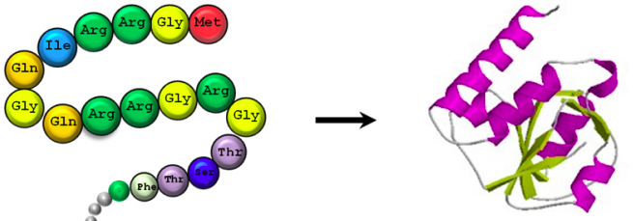

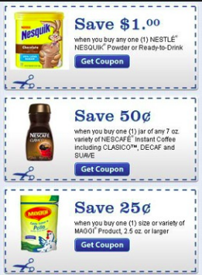
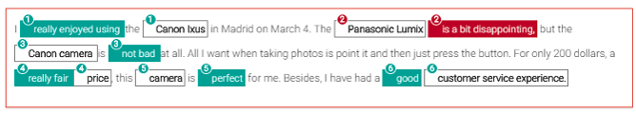
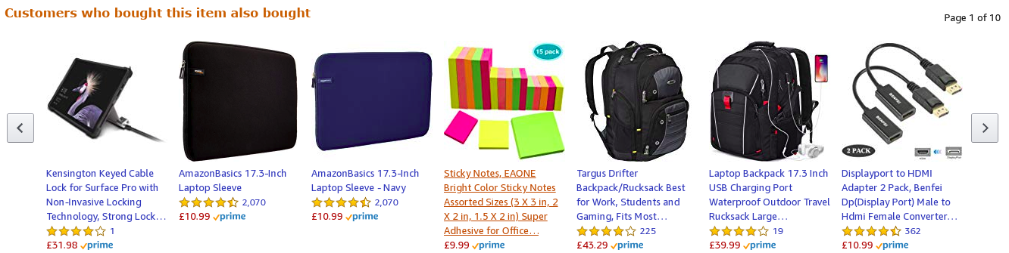
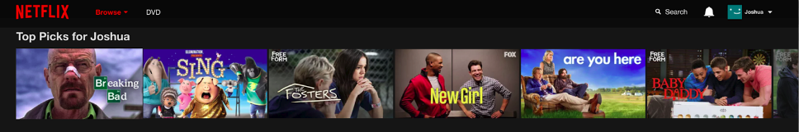
Association Analysis

Slide 3
Association Analysis
Enterprises around the world use association analysis as the base of their marketing efforts:
Amazon use it to recommend other books and products
Target use it to make personalized promotions
Spotify and Youtube use it for song recommendations
Netflix use it to show users the list of recommended films
Supermarkets use it to decide the place of products on the shelfs

Slide 4
Association Analysis
Analyzing customer reviews
Activity monitoring
Malware detection
e-Learning
Fraud Detection-Credit Card Transactions
Network traffic analysis
Customer Relationship Management (CRM)
Bioinformatics
Image classification
Medical diagnosis
Protein Sequences
Bio-Medical Literature
Census Data

Slide 5
Association Analysis
Association analysis is used in machine learning for the generation of recommendation systems.
It takes the most common combinations of items and measure their association and the likelihood that someone choosing one or more item will choose also another specific item

Slide 6
Association Analysis
An association rule is a pattern that states when an event occurs, another event occurs with certain probability
Association rules are a kind of IF...ELSE statement that tries to find if there are hidden relationships between unrelated items in a dataset

Slide 7
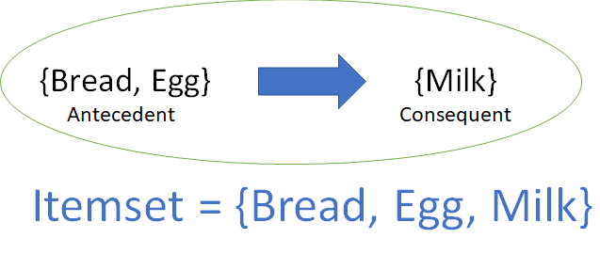
Definitions
Itemset is a list of items that consist in two parts:
Antecedent: the items that were selected previously
Consequent: the item that was selected after the antecedent
Itemset
Support
Confidence
Lift

Slide 8
Definitions
The dataset consist on a list of transactions containing various items per transaction. For the analysis we proceed with the following steps:
We build a list of all items and count the frequency of each item and order them from the most frequent to the less frequent
We take a combination of popular items from the itemset list and search for the co-occurence of both items (antecedent)
Next we analyze which items are also found as frequently occurring with the antecedent items (consequence)
Itemset
Support
Confidence
Lift

Slide 9
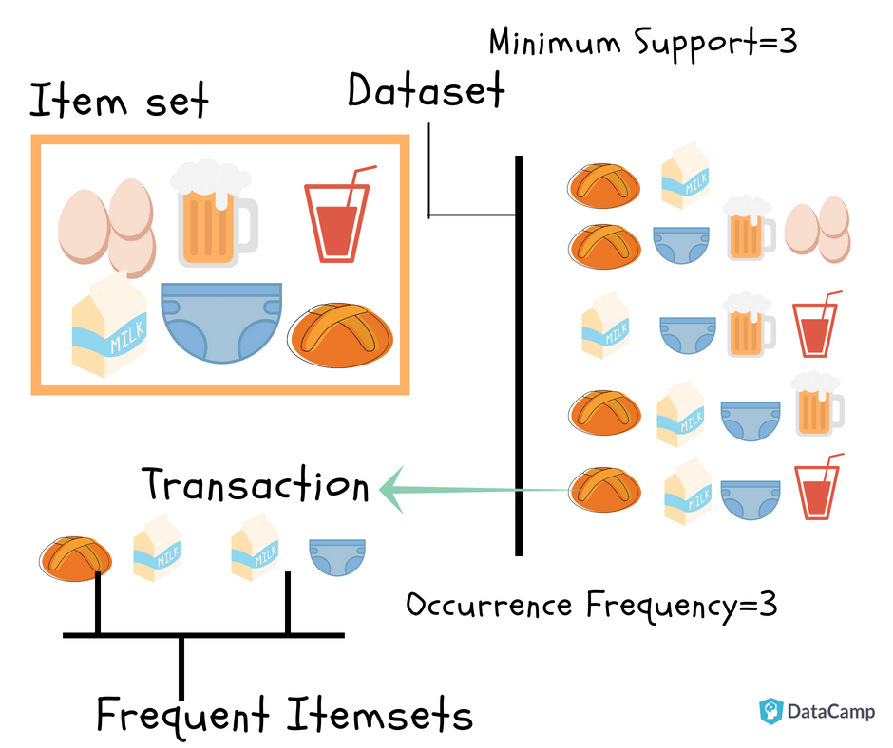
Definitions
Itemset
Support
Confidence
Lift

Slide 10
Definitions
Itemset
purchsId | transactId | Time | ItemID | ItemName
1 | 1 | 12:32 | 12 | Eggs
1 | 2 | 12:32 | 44 | Milk
1 | 3 | 12:32 | 20 | Bread
2 | 1 | 16:29 | 44 | Milk
2 | 2 | 16:29 | 46 | Yogurt
2 | 3 | 16:29 | 20 | Bread
2 | 4 | 16:29 | 58 | Beer
3 | 1 | 18:11 | 44 | Bread
Support
Confidence
Lift

Slide 11
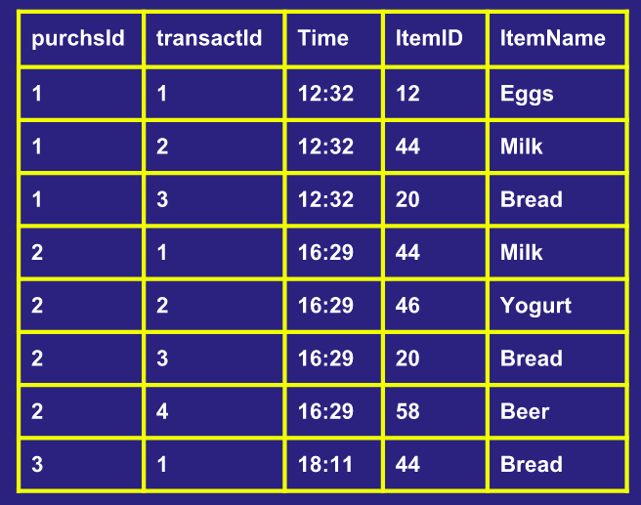
Definitions
Itemset
Item List
Item | Freq
Bread | 53
Milk | 48
Eggs | 45
Yogurt | 39
Beer | 37
Shampoo | 14
Support
Confidence
Itemset
{ Eggs, Milk, Bread }
Lift

Slide 12
Definitions
Support
Indicates how frequent an itemset appears in all the transactions
Total transactions 150 Support
{Bread} 50 50+25+20+5=90 0.6 (60%)
{Milk} 30 30+25+5=60 0.4 (40%)
{Yogurt} 20 20+20+5=45 0.3 (30%)
{Bread, Milk} 25 25+5=30 0.2 (20%)
{Bread, Yogurt} 20 20+5=25 0.17 (17%)
{Bread, Yogurt, Milk} 5 5 0.03 (3%)
Itemset
Support
Confidence
Lift

Slide 13
Definitions
The support measure helps us identify the rules worth considering for further analysis
It is difficult to understand the relationships between itemsets when the support is too low
We use it to select a threshold (limit) that will reduce the number of itemsets to only the most important
Itemset
Support
Confidence
Lift

Slide 14
Definitions
Confidence is a measure of the likeliness of occurrence of consequent on the dataset given the antecedents.
{Milk ->Rum}
Conf_{{Milk->Rum}} = (20)/50
= 0.4
Itemset
Support
Confidence
Milk
50
Rum
20 30
Lift

Slide 15
Definitions
Lift controls for the support (frequency) of consequent while calculating the conditional probability of occurrence of {Y} given {X}.
or lift_{{x->y}} = Confidence_{{x->y}} / Support_{{y}}
Conf_{{Milk->Rum}}= (20)/50
= 0.4
Sup_{{Rum}}= 30/80 = 0.375
Lift_{{Milk->Rum}}=0.4/0.375=1.07
Itemset
Support
Confidence
Milk
50
Rum
20 30
Lift

Slide 16
Definitions
Itemset
In cases where {X} actually leads to {Y} on the cart, value of lift will be greater than 1
Values of lift >1 indicates a high association between {Y} and {X}
Support
Confidence
Lift

Slide 17
Association Rules
Support_{{x,y}} = frq {x,y} / N
Rules_{{x,y}} Confidence_{{x,y}} = frq {x,y} / frq {x}
Lift_{{x,y}} = Confidence_{{x,y}} / Support_{{y}}

Slide 18
Apriori Algorithm
The apriori algorithm is useful for analyzing huge transaction datasets.
It has two basic passes that are repeated until the maximum k pairs are found:
Find the most frequent itemsets
Search for candidate pairs

Slide 19
Apriori Algorithm
Pass 1:
Find the most frequent itemsets
Order the list of all cases by their frequency and select arbitrarily a minimum number of items to be considered as frequent
Delete the items that were below this number
Pass 2:
Search for candidate pairs: generate a contingency matrix with all the frequent items. If the matrix is too large convert it to a triangular matrix.

Slide 20
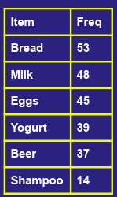
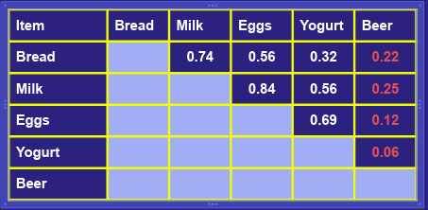
Apriori Algorithm
C1
L1
L1
C2
L2
C3
First pass
Second pass
Threshold = 0.3

Slide 21
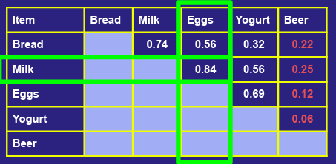
Apriori Algorithm
C1
L1
L1
C2
L2
C3
First pass
Second pass
{Eggs, Milk} -> {Bread}
{Eggs, Milk} -> {Beer}
{Eggs, Milk} -> {Bread}
Accept the triad if all appear in matrix:
{Eggs, Milk} => True
{Eggs, Bread} => True
{Milk, Bread} =>True
Accept the triad if all appear in matrix:
{Eggs, Milk} => True
{Eggs, Bear} => False
{Milk, Beer} =>False

Slide 22
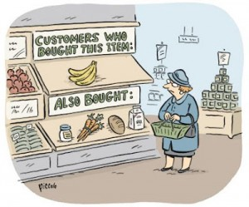
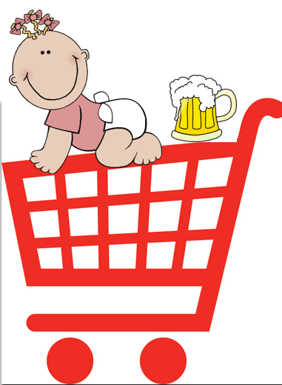
Basket Market Analysis

